Slide 1


INSTITUTE FOR ADVANCED COMPUTING AND SOFTWARE DEVELOPMENT AKURDI, PUNE
“SenitelWeb : Multi layered security approach CI/CD Pipeline
Web application deployment”
GROUP NO: 16
Ojas Jawale(233426)
Omkar Gadre (233427)
Mr. Kartik Awari Mr. Rohit Puranik
PROJECT GUIDE CENTRE CO-ORDINATOR

Slide 2
Introduction
In todays Digital security has become paramount , one of the way to achieve this is to have multilayered security approach on CICD pipeline .
Now, combining this Multilayered Security strategy with a CICD pipeline takes your application deployment to a whole new level. The CICD pipeline automates the process of building, testing, and deploying your web application, ensuring rapid and reliable releases. By integrating security into every step of this pipeline, you establish a proactive security posture, minimizing vulnerabilities from inception to production.
Imagine a scenario where each layer of your application, from the infrastructure and network to the application code and user access, is fortified with security measures tailored to its specific requirements. Firewalls, intrusion detection systems, encryption, access controls, and regular security audits all play their roles in this intricate defense mechanism.

Slide 3
Purpose
The purpose of implementing a multilayered security approach in the deployment of web applications through a Continuous Integration and Continuous Deployment (CICD) pipeline is to establish a comprehensive and proactive defense mechanism against a wide range of security threats. This approach aims to ensure the integrity, confidentiality, and availability of your web application throughout its development lifecycle, from coding to deployment and beyond.

Slide 4
Requirement
Software Hardware
1. Operating system: Debian 10
2. Firewall: IPtables
3. Platform: Amazon Web Service
4. CI Platform : Jenkins
5. Database: Mariadb
Sr.no | Components | Minimum requirements
1 | CPU | 2.5 GHz
2 | RAM | 8 GB
3 | Storage | 500 GB
4 | Network | 100 Mbps

Slide 5
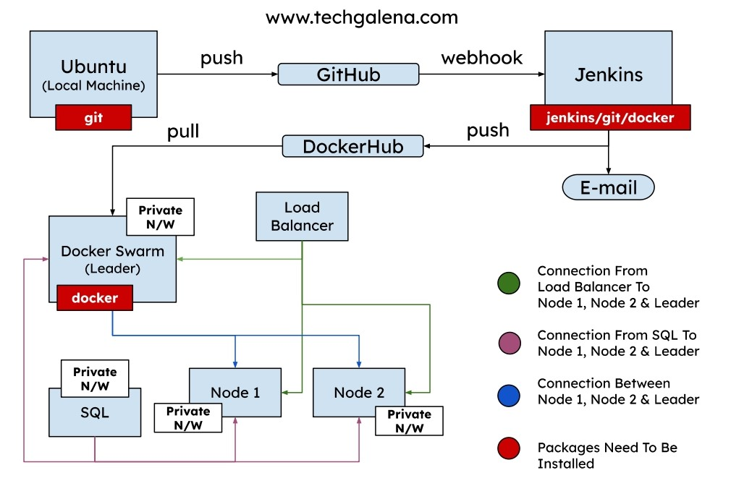
Architecture

Slide 6
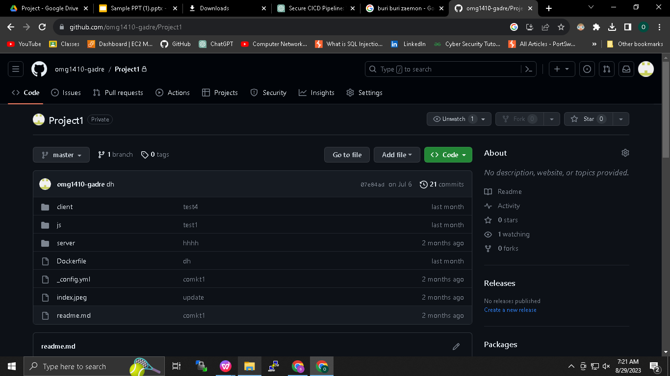
Git (Distributed Version Control System)

Slide 7
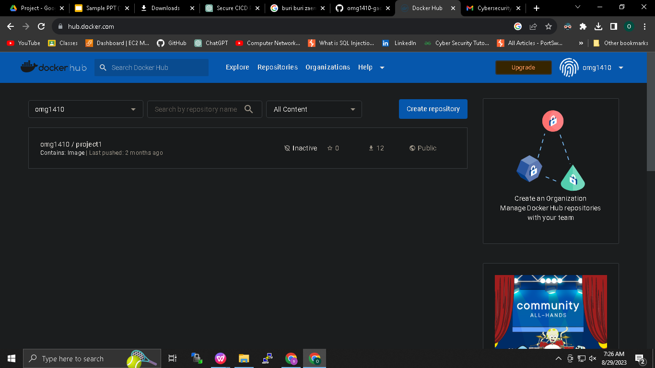
Docker Repository

Slide 8
Project Workflow

Slide 9
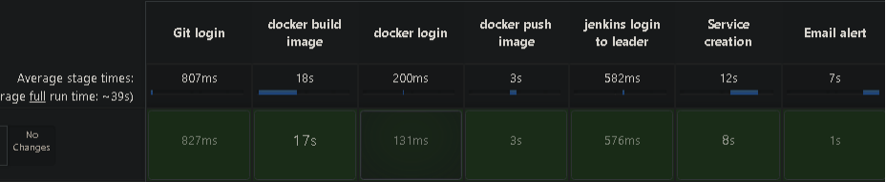
Pipeline

Slide 10
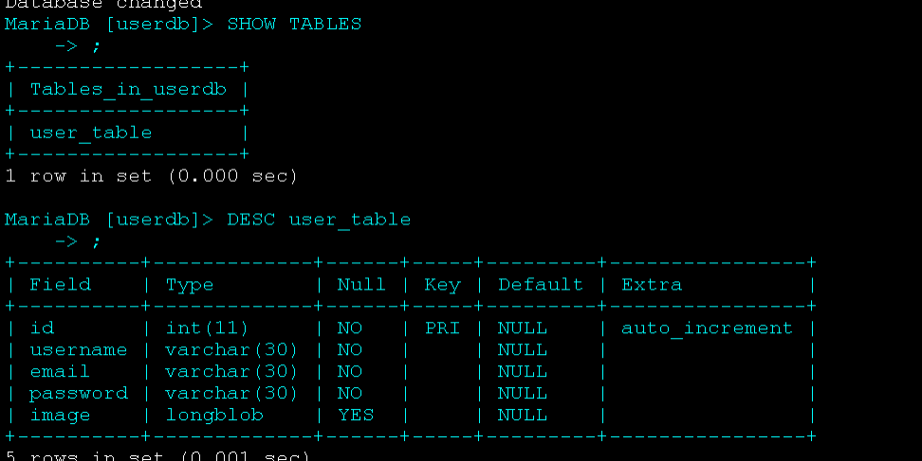
SQL Server

Slide 11
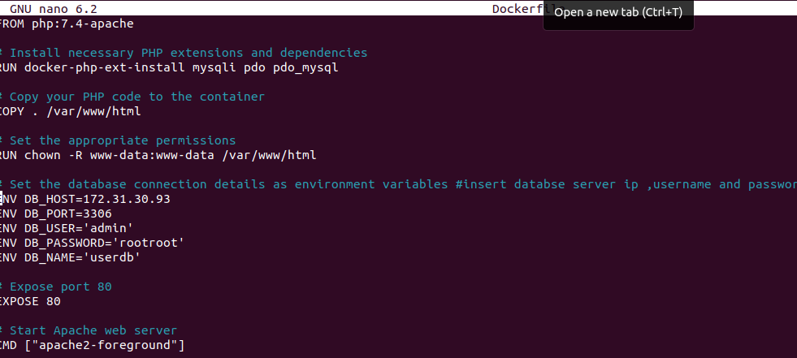
Dockerfile

Slide 12
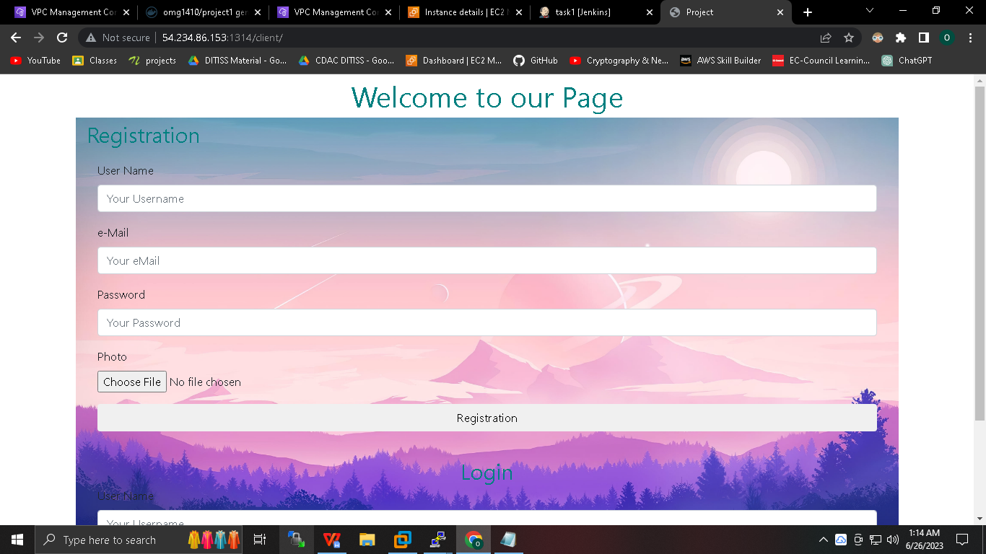
Output

Slide 13
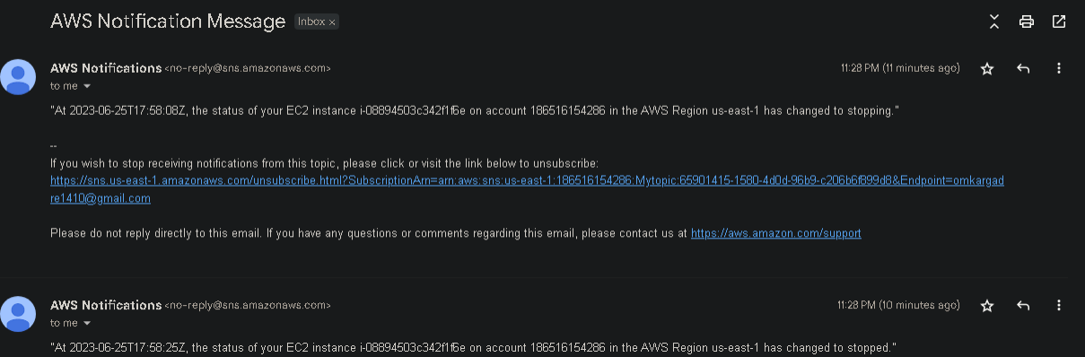
Simple Notification Service

Slide 14
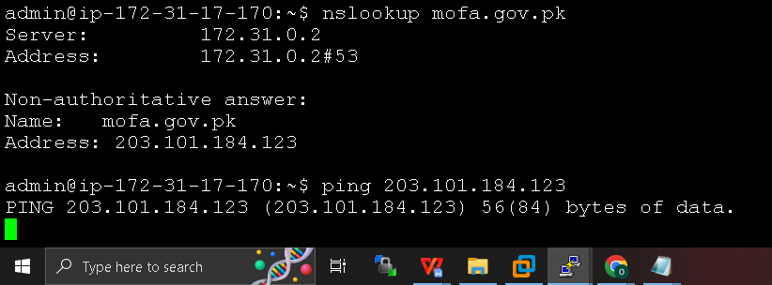
Pakistan Block

Slide 15
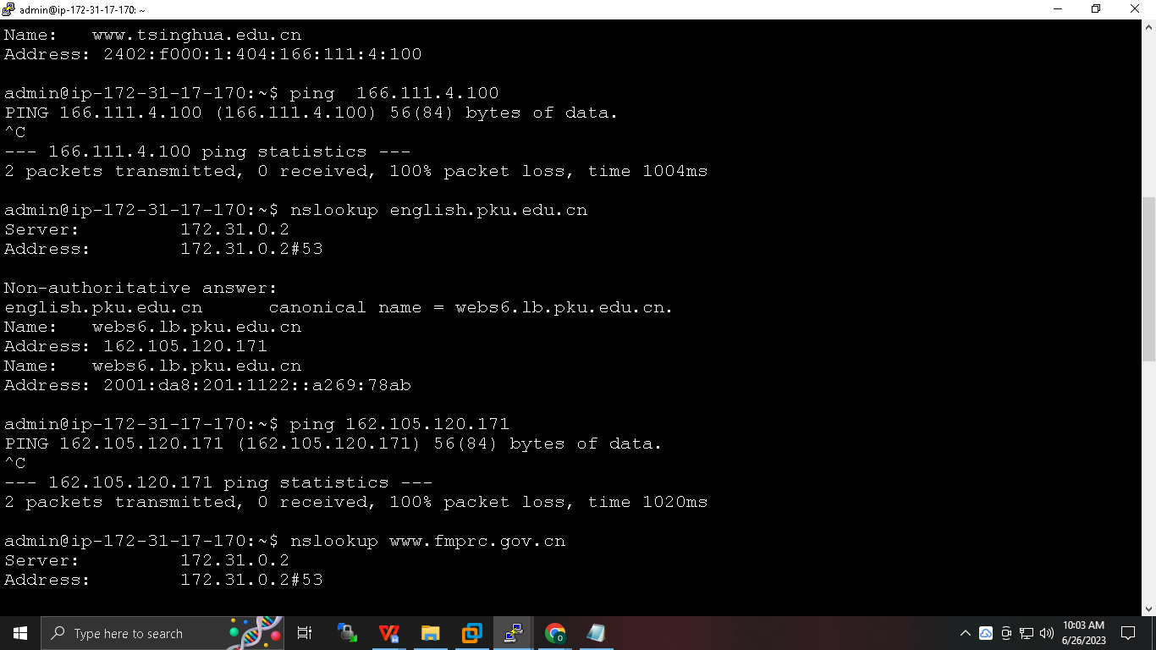
China Block

Slide 16
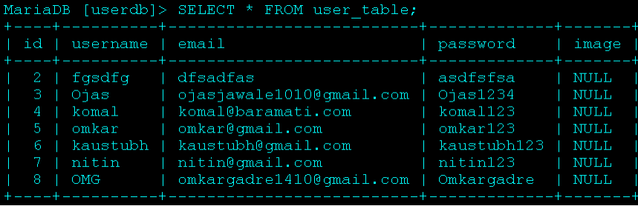
Database

Slide 17
Conclusion
The marriage of multilayered security with CI/CD practices fosters an environment of efficiency, collaboration, and continuous improvement. It enables developers to work with confidence, knowing that security is an integral part of their development journey, not a separate concern. Regular security assessments, automated scans, and code reviews become seamlessly interwoven into the development lifecycle.

Slide 18
THANK YOU

